Slide 1
Akron Metropolitan Housing Authority
Housing Choice Voucher Program

Slide 2
Summit Housing Search
FREE Service
Maintain an inventory of your properties
We direct all tenants to use www.summithousingsearch.org
Go to the website or call 1-877-428-8844 to list or update your property
Customer Service available 9am -8pm Monday-Friday
Akronhousing.org click on Social Serve log in
Akronhousing.org is a great resource to learn more about our agency and how our program works
Shary Page, 330-376-9453

Slide 3
Finding a Tenant
350-650 voucher holders looking for a unit at any time
  Currently about 600 voucher holders
  Please do not hold RTA’s if you are not ready. RTA’s will not be accepted after the expiration date.
AMHA completes a criminal background check
  3 year timeframe
3 Types of RTAs
  New to program (white)
  Transferring housing (gold)
  New to county (blue)
Christyne Mullins, 330-376-9458

Slide 4
Request for Tenancy Approval (RTA)
Most frequently delayed by:
  Blank spaces on the first page
  No signature
  No agent form
Sent to Contract and Leasing daily (C & L)
  Make sure you list a good contact phone number
  Make sure your voicemail is not full
  C & L will leave a voicemail message with pre-inspection rent estimate and allow 24 hours for response before sending RTA to inspections
  If C & L determines that we can pay requested rent, the RTA will go to inspections the same day it is reviewed
Clyde Elkins 330-376-9853; Christyne Mullins, 330-376-9458

Slide 5
2021 Payment Standards
Full list on Landlord Portal
    Payment Standard Increased Payment Standard
0 bedroom $ 566 $ 622
1 bedroom $ 730 $ 730
2 bedroom $ 933 $ 933
3 bedroom $1,069 $ 1,175
4 bedroom $1,151 $ 1,266
5 bedroom $1,324 $ 1,456
6 bedroom $1,496 $ 1,645
Increased payment standards, 110% for 44056, 44067, 44087, 44141, 44221, 44223, 44224, 44236, 44264, 44286, 44303, 44319, 44321, 44333, 44685.
Payment Standard is the gross rent of the unit, NOT the final approved rent. Gross rent is the TOTAL of rent + utilities combined. Each utility the tenant is responsible for paying changes the calculation.
Christyne Mullins, 330-376-9458

Slide 6
2021 Utility Allowances
Full list on Landlord Portal
1 STORY EXAMPLE
2 BEDROOM
2 STORY EXAMPLE
2 BEDROOM
GAS HEAT $ 51.00
ELEC HEAT $ 81.00
GAS STOVE $ 2.00
ELEC STOVE $13.00
WAT,SEW,TR $107.00
GAS HEAT $ 48.00
ELEC HEAT $ 72.00
GAS STOVE $ 2.00
ELEC STOVE $ 13.00
WAT,SEW,TR $107.00

Slide 7
Utility PAYMENTS
  Tenant:
    Qualifies for credit toward their portion of rent
    Responsible for entire amount of bill
    If disconnected from service may be terminated from program
      While in termination process the landlord will receive rent
      Landlord will receive notification if payment from AMHA will be discontinued
Landlord:
Qualifies for credit toward rent
Responsible for entire amount of bill
If disconnected from service will have HAP payment discontinued (abatement) and tenant will receive an opportunity to move
WATER DEPOSITS ARE NOT ALLOWED
Christyne Mullins, 330-376-9458

Slide 8
APPLIANCES
Appliances:
  Ownership of appliances is part of your contract with AMHA
  Fuel type matters
  Notify AMHA if either ownership or fuel type changes
  Rent adjustment will be made dependent upon ownership or fuel type
  An inspection will be ordered to verify the new appliance
  Appliance owner is responsible for repairs
Christyne Mullins, 330-376-9458

Slide 9
Rent Reasonableness
Generally takes into account:
  Number of bedrooms
  Number of bathrooms
  USPS Census Tract
  Who is paying what utilities
  Who owns the refrigerator and stove
  New Construction built in 2002 and after
Christyne Mullins, 330-376-9458

Slide 10
Initial Inspection
The first inspection will be scheduled within 14 days of your approval of the pre-inspection rent estimate
  Please do not accept the inspection appointment if you are not ready
    All utilities must be on in owner’s name until unit passes inspection
    Property must be clean
    There can be no defective paint on the inside or outside of the property
    Inspectors are instructed to discontinue the inspection if the property is not ready
    No Weather Deferrals
Use the HQS Self Inspection Form
  “50’s” list
Clyde Elkins 330-376-9853

Slide 11
Contract and Leasing
After inspection passes
  Contract will not start prior to the passed inspection date
  Finalized rental quote within 48 hours
    Can’t charge more than agreed upon contract rent
    Can’t exclude a portion of the property
      Garage, basement, attic
  Contract will be mailed within 10 business days, which will state the AMHA portion of rent as well as the client portion
  The contract, lease, and all associated paperwork must be completed, signed and submitted to AMHA within 60 days from the effective date of the contract
Christyne Mullins, 330-376-9458

Slide 12
Security Deposit and Lease
Collect at time of lease signing (if agreeable you can accept payments, document and give receipts)
You cannot charge more than one month approved contract rent
A one time pet deposit is OK, unless a companion animal, no monthly pet rent is permissible
WATER DEPOSITS ARE NOT PERMITTED ON THIS PROGRAM
Your lease must match the AMHA contract
  Start and end dates
  AMHA and client portions of rent
  Utility and appliance responsibility
  Persons in household
  3 original leases are needed: AMHA, Landlord, Tenant
Also must have original signatures and tenancy addendum
Christyne Mullins, 330-376-9458

Slide 13
Payment
Once the contract, lease and all associated documents are submitted, we will release payment to the landlord
Payments are made via direct deposit
Payments will be retroactive to the effective date of the contract
Check processing dates are available on the Landlord Portal for current landlords, new landlords will have access after the first deposit is made
Elizabeth Kaisk, 330-376-7045

Slide 14
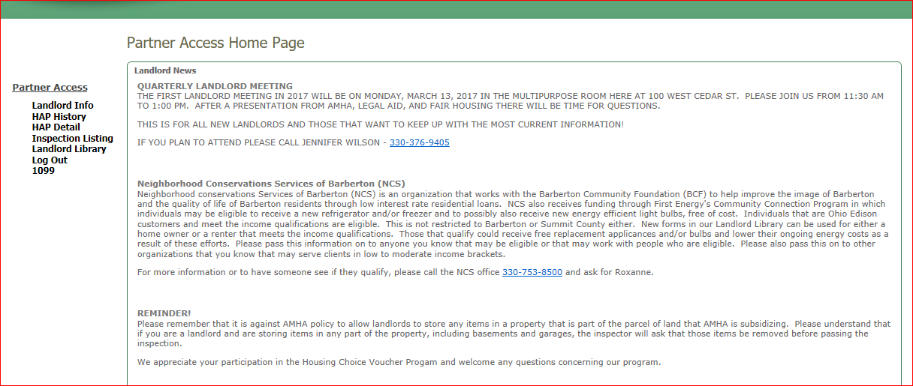
Landlord Portal
www.akronhousing.org
  Landlord Central
  Landlord Access (2nd selection on menu)
Payment information
  Click on property address to access
Inspection information
Automatic updates for your convenience
Announcements
Landlord Newsletters
Contact Al Prince to get setup on the Portal at
330-376-9853
Clyde Elkins 330-376-9853

Slide 15
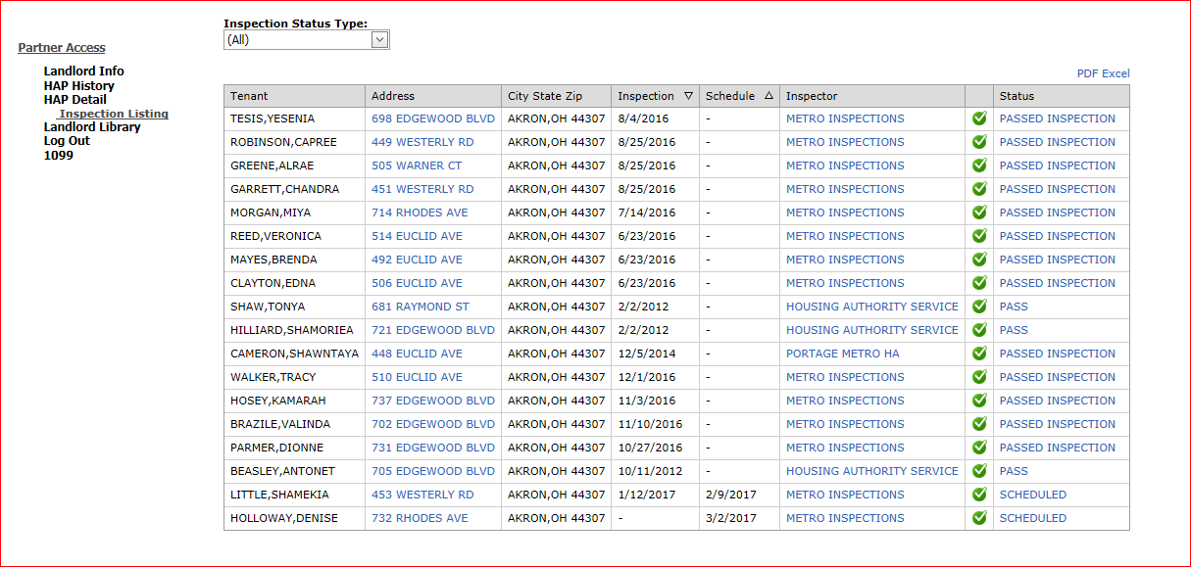
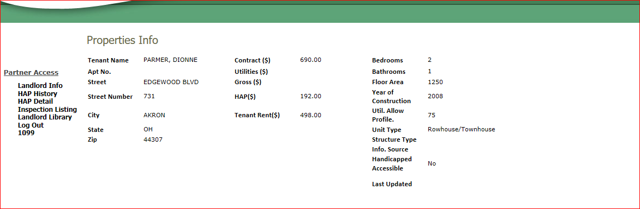
Landlord Portal
Inspection Listing
Tenant Name
Property Address:
  Click on any blue text to link further information.
Clicking on property address gives information about the property as well as tenant rent.

Slide 16
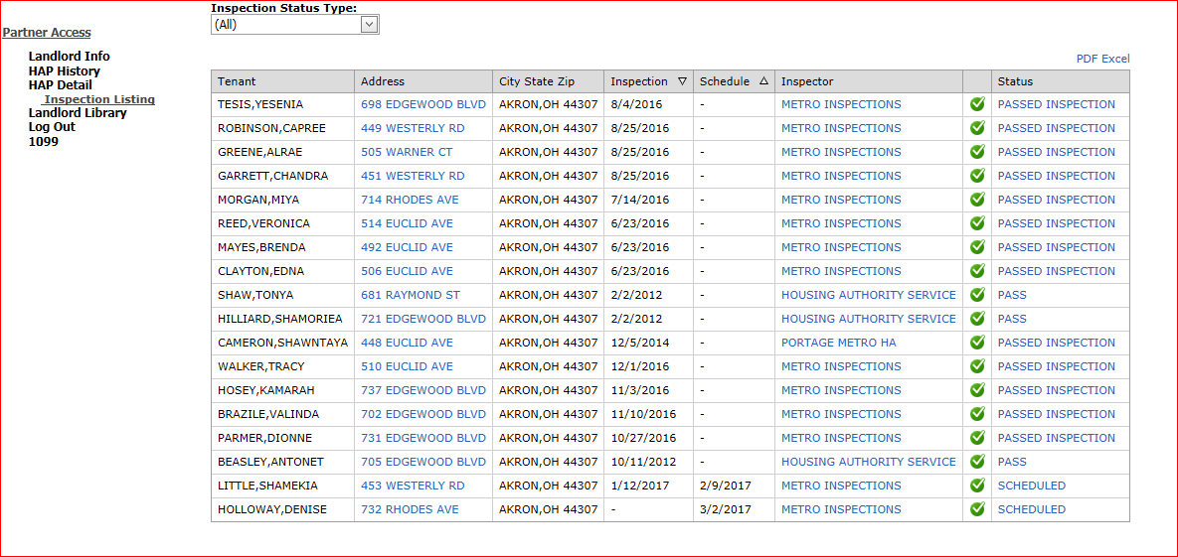
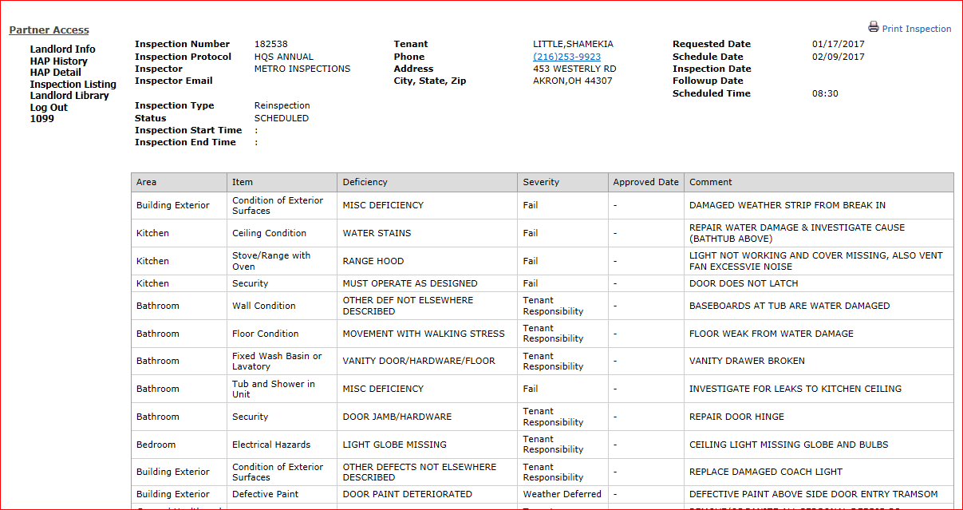
Landlord Portal
Clicking on status displays details of the inspection
This is a scheduled re-inspection with detailed failed items

Slide 17
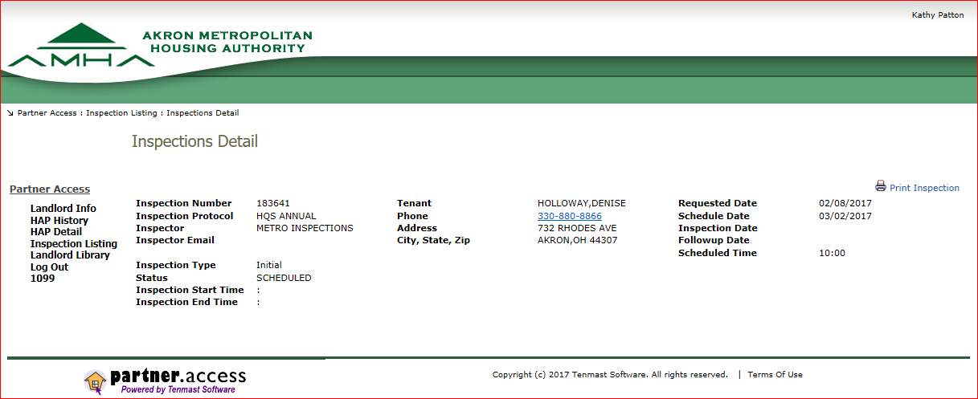
Landlord Portal
If this is the first entry inspection the scheduled inspection will display like this:

Slide 18
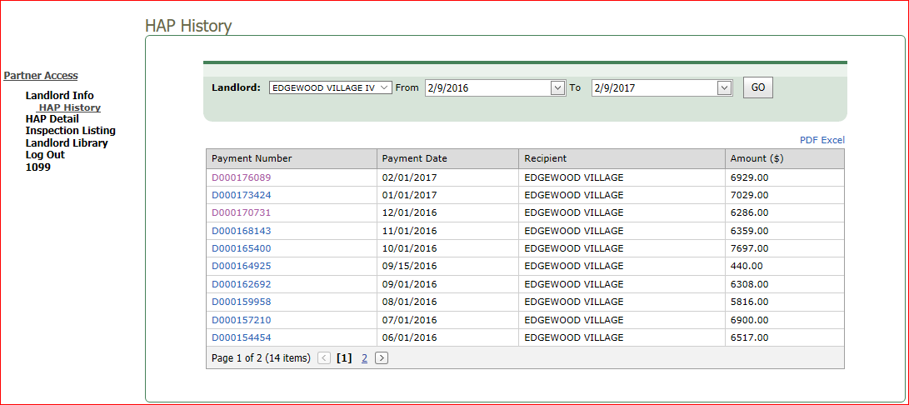
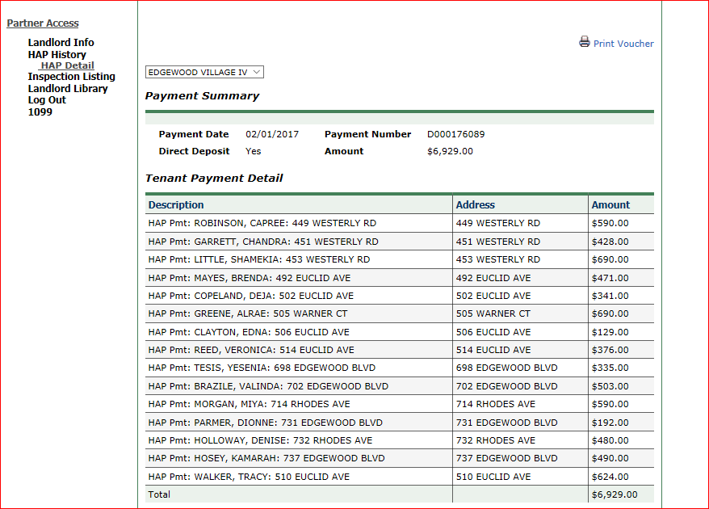
Landlord Portal
HAP History
HAP Detail

Slide 19
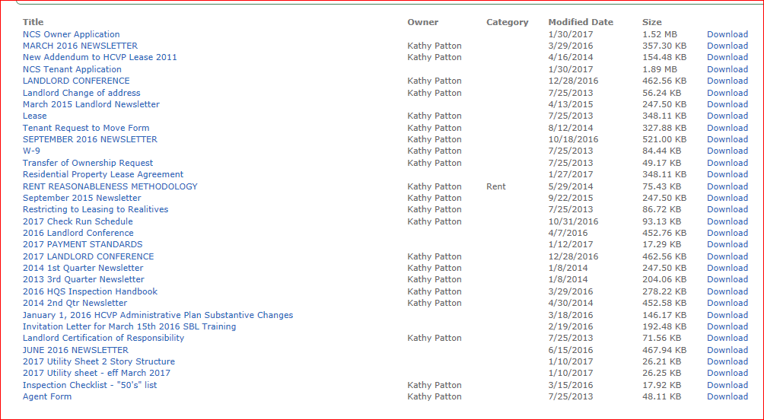
Landlord Portal
Landlord Library contains most recent documents, announcements, and frequently used forms

Slide 20
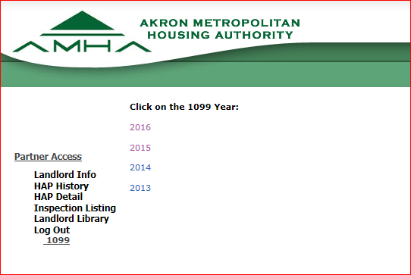
Landlord Portal
Current and previous 1099 forms are available on the portal

Slide 21
Inspections

Slide 22
Biennial Landlords
Qualifications
  No abatements in the past 2 years
  No more than 5 special inspections in the last 2 years
  Rolling calendar
  System generated
  Annual and Biennial inspections are conducted 2-3 months before the inspection is due
  3464 Units are now Biennial
Clyde Elkins 330-376-9853

Slide 23
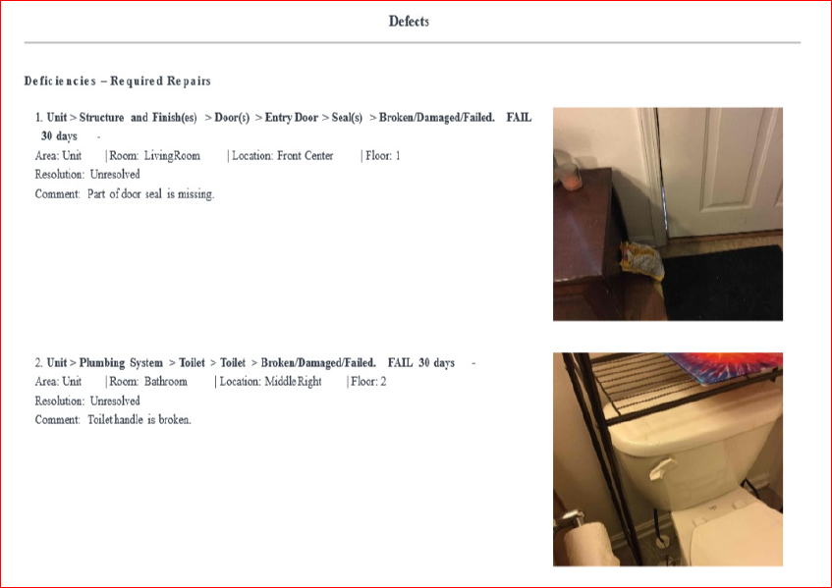
Clyde Elkins 330-376-9853

Slide 24
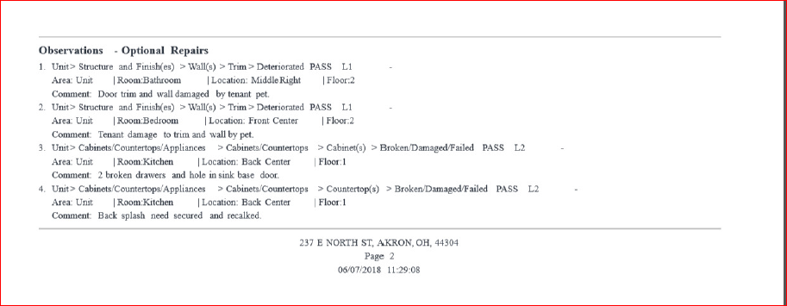

Slide 25
Lead Paint Risk
Three conditions MUST exist:
  Defective Paint
  Home built prior to 1978
  There is or will be children under the age of six in the home.
All work must be conducted by RRP certified worker unless Risk Assessment finds no lead particles above EPA limit.
Documents required to pass unit identified as a lead risk hazard:
  Copy of the Lead Paint Owner’s Certification (provided by AMHA)
  Copy of the Certified Renovator’s Certificate (RRP Certificate)
  Copy of the signed pre-renovation education form confirming receipt of the lead hazard information packet.
  Copy of the clearance report after all work is completed and cleared.
Clyde Elkins 330-376-9853

Slide 26

In an effort to avoid a lead based paint assessment, housing providers must use caution regarding the advertising of their properties. Refusing to rent, implementing different terms/conditions, or making discouraging comments on the basis of family status (households with individuals under the age of 18, women who are pregnant, and persons who are in the process of obtaining custody of individuals under the age of 18) can be seen as discrimination under the Fair Housing Act.
There are no exceptions to these regulations,
NO DEFECTIVE PAINT
Clyde Elkins 330-376-9853

Slide 27
Abatement
What is abatement?
  No Housing Assistance Payment (HAP)
  Non-refundable
    Tenants are not responsible for AMHA payment but do still need to pay their portion of rent
  Pro rated each day
When does it occur?
  Non-repair of fail items during an annual or special inspection
  Substandard repair
  Begins the day following the failed inspection date
How to minimize abatement?
  Complete repairs
  Call as soon as repairs are completed
    We will re-inspect within 5 days of your call
  Call and ask questions if you do not understand the fail item
  Don’t assume tenant will be there for you
Clyde Elkins 330-376-9853

Slide 28
UPCS - V
HUD began UPCS-V demonstration in August 2016.
AMHA began participation in May, 2018
Demonstration has been extended for two more years.
Overall Pass rates currently 70%; 2018 54%
Immediate results on HUD site.
Decision Tree software
Higher Quality, more consistent and accurate inspections.
Detailed record of unit condition
Consistent Inspections
2018 AMHA inspections were #1 in the country for accuracy.
Clyde Elkins 330-376-9853

Slide 29
New UPCS-V
CARBON MONOXIDE DETECTORS ARE NOW REQUIRED IN ALL UNIT WITH GAS APPLIANCES, FURNACES, HOT WATER TANKS OR ATTACHED GARAGES
Landlords are not permitted to store ANY items on the property including basements and garages.
No weather deferral items
Extensions only granted for major repairs when requested in writing at least 24 hours in advance of inspection.
During move in inspections if the conditions call for a Risk Assessment the landlord only has 30 days to complete the assessment and any related repairs before the RTA is cancelled.
For a 24 hour inspection the responsible party must allow entry for re-inspection.
Clyde Elkins 330-376-9853

Slide 30
Continued Assistance

Slide 31
Annual Reexaminations & Income Changes
Annually, all clients must have their income reviewed and their rental portions re-determined
Amendment letters will be sent any time the client’s portion changes
Income changes may result in a retroactive payment to the owner, for example:
    November 15th a client reports they lost their job. AMHA processes the change January 4th to reduce the client rent from $200 to $100, effective December 1. AMHA will pay the owner the $100 difference at the next check cycle.
    The amendment letter will state that the owner must reimburse or credit the resident due to the overpayment of rent.
Kathy Patton 330-376-9366

Slide 32
Additions to the Household
Adults added to the household are required to complete a criminal background check and the client must submit an approval letter from the owner before we will add them to the household
Unauthorized persons
  Persons living in the unit that are not on the lease
  May receive a letter about a possible unauthorized person or an investigation
Shary Page, 330-376-9453

Slide 33
Lease violations
If a resident is violating the terms of the lease, owners are required to take action
AMHA is not a party to the lease and therefore is only able to take action against a resident if the landlord takes action against the resident
  For example:
    If a resident causes damage to the unit, non-payment of rent, or other violations of the lease, AMHA will take no action unless the owner provides proof of eviction or a judgment against the resident
    If that happens, we will propose cancellation of the client’s voucher
    If the owner does nothing, the resident will retain their voucher
    Please submit a copy of any documentation given to the tenant as a result of a lease violation to the Continued Assistant Supervisor
Kathy Patton 330-376-9366

Slide 34
Violence Against Women Act
(VAWA)
All Public Housing Authorities are required to notify applicants and participants in the Housing Choice Voucher and Low Rent Public Housing programs about important protections for victims of domestic violence, dating violence, sexual assault, and stalking.
VAWA protects qualified tenants, participants, applicants, and affiliated individuals who are victims or threatened victims of domestic violence, dating violence, sexual assault, or stalking from being denied housing assistance, evicted, or terminated from housing assistance based on acts of such violence against them.
Kathy Patton 330-376-9366

Slide 35
HCVP does not offer legal advice

Slide 36
Rent Review
Rent increases cannot be granted more than once every 12 months.
Sometimes requests for rent increases can result in rent decreases.
Rent increase requests should be submitted 60 days prior to when they are to become effective.
The required information is tenant name, address, and dollar amount requested.
All requests must be in writing to cmullins@akronhousing.org or fax to 330-374-5088.
Christyne Mullins, 330-376-9458

Slide 37
Ownership
Please notify the Account Specialist immediately with any changes in:
  Address
  Phone Number
  Bank Account
  Ownership
If ownership of the unit changes, the owner must inform AMHA immediately or payment may continue to go to the previous owner
  The new owner will be paid on the next monthly HAP processing cycle following receipt of all completed paperwork
Elizabeth Kaisk, 330-376-7045

Slide 38
Moving
After a client has lived in a unit for 1 year they are eligible to receive another voucher to move
In order to move, all clients must submit a Request to Move form signed off on by the owner
  Move out date on the form can be updated at any time
    It’s up to the current landlord to monitor the exact move out date
  Many clients do not choose to move after receiving a new voucher
    About 50% do not use their vouchers
Christyne Mullins, 330-376-9458

Slide 39
Moving Continued
If your client has moved out, please notify the Continued Assistance Supervisor.
  Payment will stop at the end of the month in which they moved out
  Overpayment of rent will be expected to be returned to AMHA
When asking a tenant to leave, please give them as much notice as possible so they have time to receive a new voucher and comply with your request.
Kathy Patton 330-376-9366

Slide 40
Termination of the lease
When the lease is terminated, the contract terminates, and vice versa
Contracts can be terminated by AMHA if the unit fails three annual or special inspections, or any family obligation violation
Lease can be terminated by the landlord with proper notice or through eviction
Lease termination may require landlord to return HAP paid to previous landlord
Kathy Patton, 330-376-9366

Slide 41
Thank you
Any questions?

