Slide 1
Akron Metropolitan Housing Authority
Housing Choice Voucher Program

Slide 2
Summit Housing Search
FREE Service
Maintain an inventory of your properties
We direct all tenants to use www.summithousingsearch.org
Go to the website or call 1-877-428-8844 to list or update your property
Customer Service available 9am -8pm Monday-Friday
Shary Page, 330-376-9453

Slide 3
Finding a Tenant
350-500 voucher holders looking for a unit at any time
AMHA completes a criminal background check
Timeframe for background check is changing effective 1/1/16
3 year timeframe
3 Types of RTAs
New to program (white)
Transferring housing (gold)
New to county (blue)
Christyne Mullins, 330-376-9458

Slide 4
Request for Tenancy Approval (RTA)
Most frequently delayed by:
Blank spaces on the first page
No signature
No agent form
Sent to Contract and Leasing daily (C & L)
Make sure you list a good contact phone number
Make sure your voicemail is not full
C & L will leave a voicemail message with pre-inspection rent estimate and allow 24 hours for response before sending RTA to inspections
If C & L determines that we can pay requested rent, the RTA will go to inspections the same day it is reviewed
Kathy Patton, 330-376-9366; Christyne Mullins, 330-376-9458

Slide 5
Average contract rent
0 bedroom $424
1 bedroom $527
2 bedroom $551
3 bedroom $651
4 bedroom $719
Christyne Mullins, 330-376-9458

Slide 6
Rent Reasonableness
Generally takes into account:
Number of bedrooms
Number of bathrooms
Area
Who is paying what utilities
Who owns the refrigerator and stove
New Construction built in 2002 and after
HUD Rule on utilities
Christyne Mullins, 330-376-9458

Slide 7
Rent is not determined by
Recent upgrades to the home
Central air
Dishwasher
New carpet
New paint
Christyne Mullins, 330-376-9458

Slide 8
Utility Payments/Appliances
Utility Responsibility
Tenant:
Qualifies for credit toward their portion of rent
Responsible for entire amount of bill
If disconnected from service may be terminated from program
While in termination process the landlord will receive rent
Landlord will receive notification if payment from AMHA will be discontinued
Landlord:
Qualifies for credit toward rent
Responsible for entire amount of bill
If disconnected from service will have payment discontinued and tenant will receive an opportunity to move
Appliances:
Ownership of appliances are part of your contract with AMHA
Fuel type matters
Notify AMHA if either ownership or fuel type changes
Rent adjustment will be made dependant upon ownership or fuel type
An inspection will be ordered to verify the new appliance
Christyne Mullins, 330-376-9458

Slide 9
Initial Inspection
The first inspection will be scheduled within 14 days of your approval of the pre-inspection rent estimate
Please do not accept the inspection appointment if you are not ready
All utilities must be on
Property must be clean
There can be no defective paint on the inside or outside the property
Inspectors are instructed to discontinue inspection if property is not ready
Use the HQS Self Inspection Form
“50’s” list
Available in the Landlord Portal Library
Kathy Patton, 330-376-9366

Slide 10
Initial Inspection
Three chances to pass inspection
Must pass inspection within 30 days from the first inspection
Fail Examples:
Missed appointments
No utilities
Property not prepared
Kathy Patton, 330-376-9366

Slide 11
Contract and Leasing
After inspection passes
Contract will not start prior to the passed inspection date
Finalized rental quote within 48 hours
Can’t charge more than agreed upon contract rent
Contract will be mailed within 10 business days, which will state the AMHA portion of rent as well as the client portion
The contract, lease, and all associated paperwork must be completed, signed and submitted to AMHA within 60-days from the effective date of the contract
Christyne Mullins, 330-376-9458

Slide 12
Security Deposits
Collect at time of lease signing (if agreeable you can accept payments, document and give receipts)
You cannot charge more than one month approved contract rent
A one time pet deposit is OK, unless a companion animal, no monthly pet rent is permissible
Christyne Mullins, 330-376-9458

Slide 13
Lease
Your lease must match the AMHA contract
Start and end dates
AMHA and client portions of rent
Utility and appliance responsibility
Persons in household
Also must have original signatures and tenancy addendum
Christyne Mullins, 330-376-9458

Slide 14
Payment
Once the contract, lease and all associated documents are submitted, we will release payment to the landlord
Payments are made via direct deposit
Payments will be retroactive to the effective date of the contract
Check processing dates are available on the Landlord Portal
Elizabeth Kaisk, 330-376-7045

Slide 15
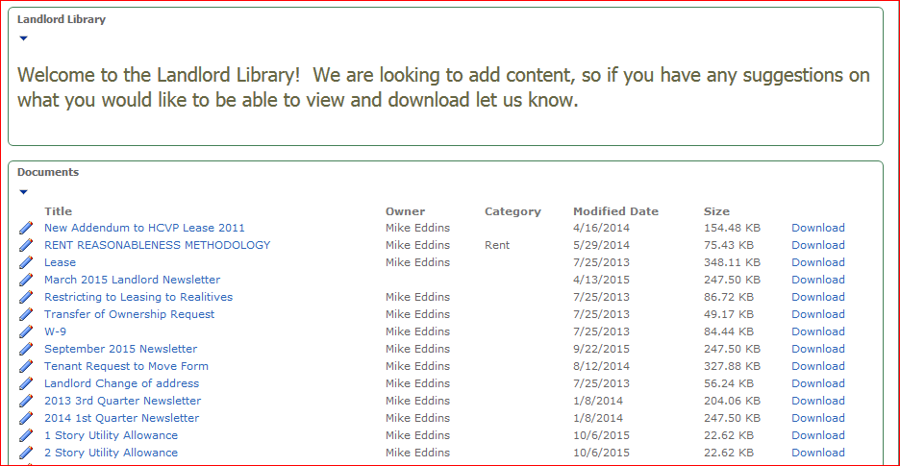
Landlord Portal
www.akronhousing.org
Landlord Central
Landlord Access (2nd selection on menu)
Payment information
Inspection information
Automatic updates for your convenience
Announcements
Landlord Newsletters
Suggestions for enhancements?
Online training?
Contact Kathy Patton to get setup on the Portal at
330-376-9366
Kathy Patton, 330-376-9366

Slide 16
Inspections

Slide 17
Who are the inspectors?
Currently have 3 Full Time Inspectors
Tom Baugher – 26 years experience
North to Northfield, East to Mogadore, West to N Hawkins area
Ray Trillet – 24 years experience
East to Goodyear Heights, Firestone Park, Kenmore
Amy Polk – 10 years experience
Barberton, Southern Summit County, West Akron, Fairlawn, Central
Schedulers: Troy Sutton and Dunel Howard
Also earned HQS Certification to go out on inspections as needed
HQS Supervisor: Kathy Patton
Quality Control Inspections

Slide 18
Biennial Landlords
Qualifications
No abatements in the past 2 years
No more than 5 special inspections in the last 2 years
Rolling calendar
System generated
First landlords included in program July 1, 2015
Annual and Biennial inspections are conducted 2-3 months before the inspection is due
Kathy Patton, 330-376-9366

Slide 19
Inspections
Average pass rates:
Improvement suggestions:
Use self inspection list before inspection
Conduct periodic inspections of your property
Address tenant complaint calls promptly
Call scheduler/inspector if you are not sure about a repair or to check violation
Review HQS handbook
Biennial Qualifications
Annual inspections 41%
Initial inspections 30%
Special/Emergency inspections 19%
Kathy Patton, 330-376-9366

Slide 20
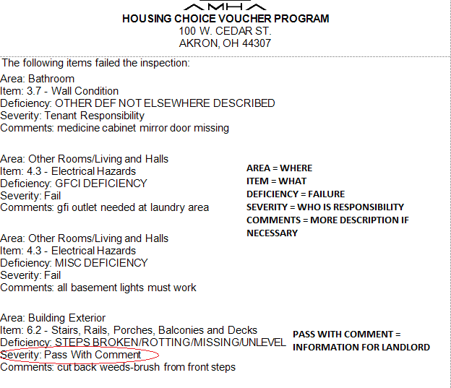
Inspection Report
Area:
Preformatted description of where the inspector observed the fail item
Item _._:
Indicates what Housing Quality Standard was used to determine a failed item
Deficiency:
The description of what failed. Preformatted categories, generally designed to closely match the actual fail item
Severity:
States who is responsible to correct the failed item
Comments:
Detailed description of failed item. Sometimes includes more specific location information
Kathy Patton, 330-376-9366

Slide 21
Lead Paint Risk
Three conditions MUST exist:
Defective Paint
Home built prior to 1978
There is or will be children under the age of six in the home.
All work must be conducted by RRP certified worker unless Risk Assessment finds no lead particles above EPA limit.
Documents required to pass unit identified as a lead risk hazard:
Copy of the Lead Paint Owner’s Certification (provided by AMHA)
Copy of the Certified Renovator’s Certificate (RRP Certificate)
Copy of the signed pre-renovation education form confirming receipt of the lead hazard information packet.
Copy of the clearance report after all work is completed and cleared.
5. In an effort to avoid a lead based paint assessment, housing providers must use caution regarding the advertising of their properties. Refusing to rent, implementing different terms/conditions, or making discouraging comments on the basis of family status (households with individuals under the age of 18, women who are pregnant, and persons who are in the process of obtaining custody of individuals under the age of 18) can be seen as discrimination under the Fair Housing Act.
Kathy Patton, 330-376-9366

Slide 22
There are no exceptions to these regulations, so make sure there is no defective paint!
Kathy Patton, 330-376-9366

Slide 23
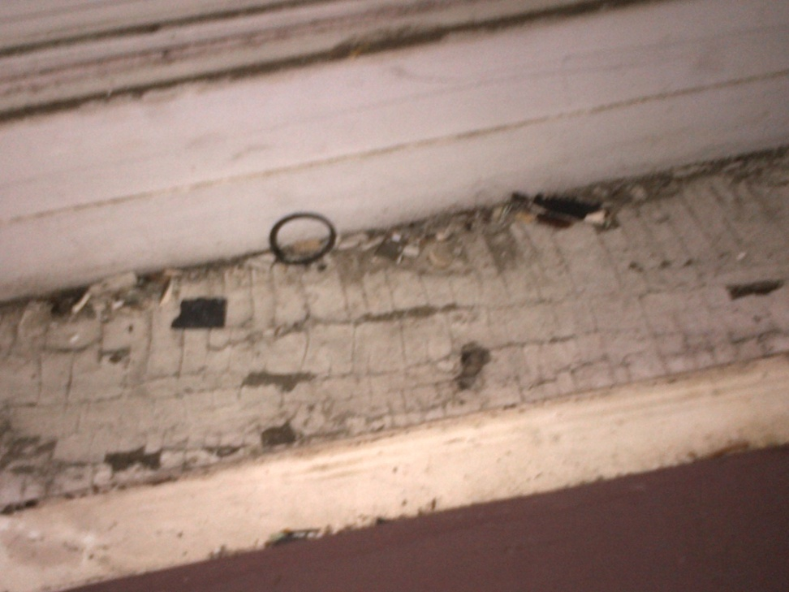
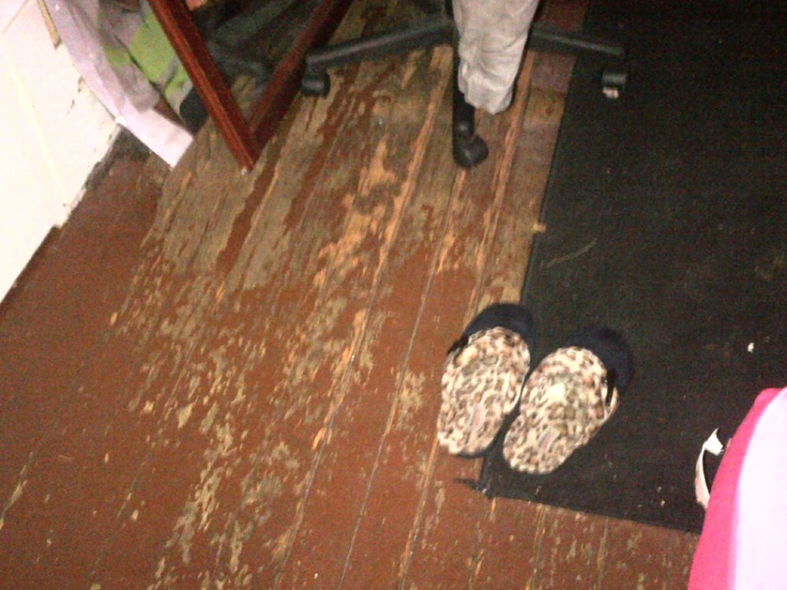
Examples of Lead Risk
Window sills
Floors
Kathy Patton, 330-376-9366

Slide 24
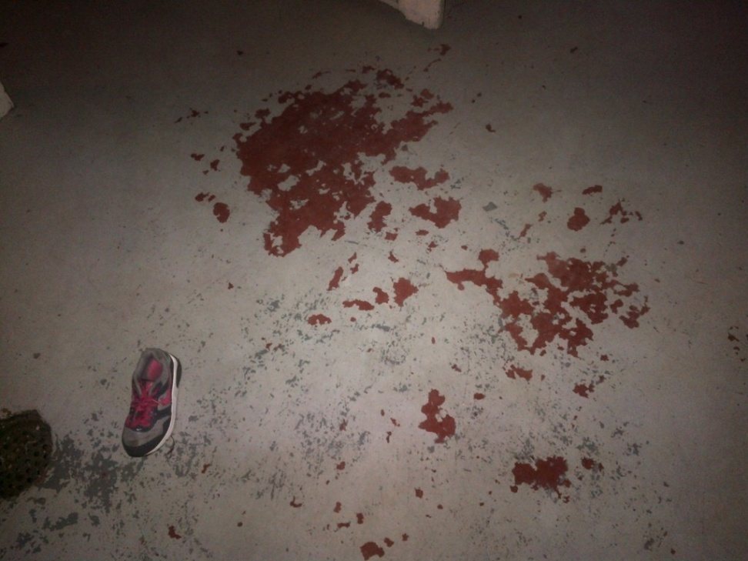
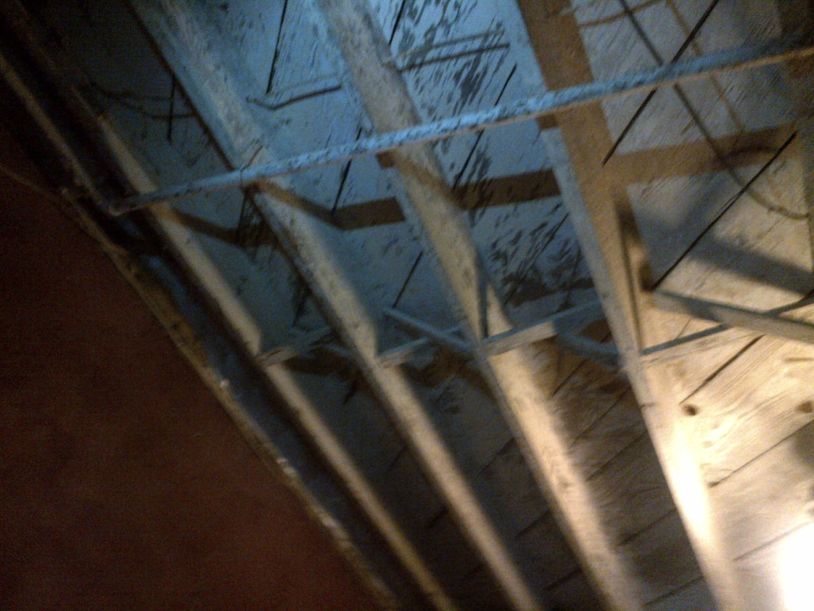
Examples of Lead Risk
Basement Floor
Basement Ceiling
Kathy Patton, 330-376-9366

Slide 25
Abatement
What is abatement?
No Housing Assistance Payment (HAP)
Non-refundable
Tenants are not responsible for AMHA payment but do still need to pay their portion of rent
Pro rated each day
When does it occur?
Non-repair of fail items during an annual or special inspection
Substandard repair
Begins the day following the failed inspection date
How to minimize abatement?
Complete repairs
Call as soon as repairs are completed
We will re-inspect within 5 days of your call
Call and ask questions if you do not understand the fail item
Don’t assume tenant will be there for you
Kathy Patton, 330-376-9366

Slide 26
Continuing Assistance

Slide 27
Annual Reexaminations & Income Changes
Annually, all clients must have their income reviewed and their rental portions re-determined
Amendment letters will be sent any time the client’s portion changes
Income changes may result in a retroactive payment to the owner, for example:
November 15th a client reports they lost their job. AMHA processes the change January 4th to reduce the client rent from $200 to $100, effective December 1. AMHA will pay the owner the $100 difference at the next check cycle.
The amendment letter will state that the owner must reimburse or credit the resident due to the overpayment of rent.
Michelle Balentine - 330-376-9853

Slide 28
Additions to the Household
Adults added to the household are required to complete a criminal background check and the client must submit an approval letter from the owner before we will add them to the lease
Unauthorized persons
Persons living in the unit that are not on the lease
May receive a letter about a possible unauthorized person or an investigation
Shary Page, 330-376-9453

Slide 29
Lease violations
If a resident is violating the terms of the lease, owners are required to take action
AMHA is not a party to the lease and therefore is only able to take action against a resident if the landlord takes action against the resident
For example:
If a resident causes damage to the unit, non-payment of rent, or other violations of the lease, AMHA will take no action unless the owner provides proof of eviction or a judgment against the resident.
If that happens, we will propose cancellation of the client’s voucher
If the owner does nothing, the resident will retain their voucher
Michelle Balentine, 330-376-9853

Slide 30
HCVP does not offer legal advice

Slide 31
Rent Review
Rent reviews cannot be requested until after the end of the initial lease term and no more than once every 12 months
Sometimes requests for rent increases can result in rent decreases
Rent increase requests should be submitted 60 days prior to when they are to become effective
Christyne Mullins, 330-376-9458

Slide 32
Ownership
Please notify us immediately with any changes in:
Address
Phone Number
Bank Account
Ownership
If ownership of the unit changes, the owner must inform AMHA immediately or payment may continue to go to the previous owner
The new owner will be paid on the next monthly check processing cycle following receipt of all completed paperwork
Elizabeth Kaisk, 330-376-7045

Slide 33
Moving
After a client has lived in a unit for 1 year they are eligible to receive another voucher to move
In order to move, all clients must submit a Request to Move form signed off on by the owner
If the owner indicates that there are balances owed or violations with the resident, AMHA may not issue the resident a voucher to move
Move out date on the form can be updated at any time
Payments will continue until client has actually moved out
Many clients do not choose to move after receiving a new voucher
Christyne Mullins, 330-376-9458

Slide 34
Moving Continued
If your client has moved out, please notify AMHA
Payment will stop at the end of the month in which they moved out
We will have to deduct the payments you received if we are not notified timely that the tenant moved out
When asking a tenant to leave, please give them as much notice as possible so they have time to receive a new voucher and comply with your request
Michelle Balentine, 330-376-9853

Slide 35
Termination of the lease
When the lease is terminated, the contract terminates, and vice versa
Contracts can be terminated by AMHA if the unit fails three annual or special inspections
Lease can be terminated by the landlord with proper notice or through eviction
Kathy Patton, 330-376-9366; Michelle Balentine, 330-376-9853

Slide 36
Who to contact with questions?
Shary Page– HCVP Manager
330-376-9453
Kathy Patton – Inspections, Landlord Portal
330-376-9366
Christyne Mullins – Contract and Leasing, Rent Reviews
330-376-9458
Michelle Balentine– Annual/Interim Reexaminations, Household Additions
330-376-9853
Elizabeth Kaisk – HAP payments, Landlord changes
330-376-7045

Slide 37
Thank you
Any questions?

